Slide 1
Pointers
Lecture 14
Notes:
Narrator:
Lecture 14: Introduction to Pointers

Slide 2
POINTERS
Pointers are variables that contain memory addresses as their values.
A variable name directly references a value.
A pointer indirectly references a value. Referencing a value through a pointer is called indirection.
A pointer variable must be declared before it can be used.
Notes:
Instructor:
Students have already used pointer without knowing it when they declare FILE variables, which basically point to the address where a file stream is located.
Narrator:
Pointers are variables that contain instead of data, the memory address where the data exists as their values. It can be said that a regular variable name directly references the value in that variable. A pointer, on the other hand, indirectly references a value. Referencing through a pointer is called indirection. Like any other variable, a pointer must be declared before it can be used.

Slide 3
Concept of Address and Pointers
Memory can be conceptualized as a linear set of data locations.
Variables reference the contents of a locations
Pointers have a value of the address of a given location
ADDR1
Contents1
ADDR2
ADDR3
ADDR4
ADDR5
ADDR6
*
*
*
ADDR11
Contents11
*
*
ADDR16
Contents16
Notes:
Instructor:
A computer has two basic types of busses to the memory: an address and data bus. Thus far we have been concerned mainly with the data we store but not its storage location. Pointers allow us to also use the address in which our data is stored in various ways. This conceptualization of memory can be likened to a street with various address where mail is delivered. The mailman delivers the correct data (letters) to the correct address written on each piece of mail.

Slide 4
POINTERS
Examples of pointer declarations:
FILE *fptr;
int *a;
float *b;
char *c;
The asterisk, when used as above in the declaration, tells the compiler that the variable is to be a pointer, and the type of data that the pointer points to, but NOT the name of the variable pointed to.
Notes:
Instructor:
Pointers can be declared with regular variables in the same line, the asterisk (or lack of one) determines if the variable will contain an address or data. It is important to declare the correct type of pointer depending on the type of data it will point to. It is NOT possible to give a variable and pointer the same name. All variables (pointer or data) must still have a unique name.
Narrator:
Pointers are declared much like variables, except an asterisk must be before each variable name. Pointers can be declared with regular variables in the same line, the asterisk (or lack of one) determines if the variable will contain an address or data. It is important to declare the correct type of pointer depending on the type of data it will point to. It is NOT possible to give a variable and pointer the same name. All variables (pointer or data) must still have a unique name.

Slide 5
POINTERS
Consider the statements:
#include <stdio.h>
int main ( )
{
FILE *fptr1 , *fptr2 ; /* Declare two file pointers */
int *aptr ; /* Declare a pointer to an int */
float *bptr ; /* Declare a pointer to a float */
int a ; /* Declare an int variable */
float b ; /* Declare a float variable */
Notes:
Instructor:
In this case the pointer and variable declarations are separated. They could have also been handled as such:
FILE *fptr1, *fptr2;
int *aptr, a;
int *bptr, b;
Narrator:
In these statements we are declaring pointers of multiple types, along with the familiar FILE pointer type. We also declare normal variables. In this case the pointer and variable declarations are separated. Pointers and variables of the same type could have been declared on the same line, separated by commas.

Slide 6
POINTERS
/* Then consider the statements: */
aptr = &a ;
bptr = &b ;
fptr2 = fopen ( "my_out_file.dat" , "w" ) ;
fptr1 = fopen ( "my_in_file.dat" , "r" ) ;
if ( fptr1 != NULL )
{
fscanf ( fptr1, "%d%f" , aptr , bptr ) ;
Notes:
Instructor/Narrator:
Remember that including the ampersand (&) before any variable’s name returns its location in memory (first introduced with scanf() and fscanf()). So to set a pointer to the location in memory of a variable we simply set the pointer equal to the variable with a preceding ampersand such as those shown. We can then use the fscanf with the pointers aptr and bptr instead of &a and &b since both return the same information (the memory location of variables a and b).

Slide 7
POINTERS
fprintf ( fptr2, "%d %d\n" , aptr , bptr ) ;
fprintf ( fptr2, "%d %f\n" , *aptr , *bptr ) ;
fprintf ( fptr2, "%d %f\n" , a , b ) ;
fprintf ( fptr2, "%d %d\n" , &a , &b ) ;
return 0 ;
}
Assuming that the above is part of a program that runs without error and the the input file does open, what would be printed to the file
By the first fprintf? By the second fprintf?
By the third fprintf? By the fourth fprintf?
Notes:
Instructor:
Remember fprintf() returns the value stored in a variable (without the need of a preceding ampersand).
1st fprintf: returns the values stored in aptr and bptr (the memory locations of a and b). (the addresses)
2nd fprintf: returns the values stored in the memory locations stored in aptr and bptr (the actual values of a and b). (the data) – called dereferencing a pointer
3rd fprintf: returns the values of a and b (the data)
4th fprintf: returns the memory locations of a and b (the addresses)
Narrator:
Notice the difference in the variables printed in each fprintf() function here. Can you determine which variable will print which values?
1st fprintf: returns the values stored in aptr and bptr (the memory locations of a and b). (the addresses)
2nd fprintf: returns the values stored in the memory locations stored in aptr and bptr (the actual values of a and b). (the data) – called dereferencing a pointer
3rd fprintf: returns the values of a and b (the data)
4th fprintf: returns the memory locations of a and b (the addresses)

Slide 8
Use of & and *
When is & used?
When is * used?
& -- "address operator" which gives or produces the memory address of a data variable
* -- "dereferencing operator" which provides the contents in the memory location specified by a pointer
Notes:
Instructor:
Use the & when you wish to know the address of a variable.
Use the * when you wish to return the value stored in the variable as an address, then look in that address and return its data
Narrator:
With the introduction of pointers, we now have the & and the * being used for various operations. The & is used when you wish to know the address of a variable. This is known as the address operator. The *, or dereferencing operator, provides the contents of the memory location specified by a pointer. This operation takes the value stored in the pointer as an address, looks in that address and returns the data stored there.

Slide 9
POINTERS
aptr = &a ;
bptr = &b ;
fptr2 = fopen ( "my_out.dat" , "w" ) ;
fptr1 = fopen ( "my_in.dat" , "r" ) ;
if ( fptr1 != NULL )
{
fscanf (fptr1, "%d%f", aptr, bptr);
fprintf (fptr2, "%d %d\n", aptr, bptr ) ;
fprintf (fptr2, "%d %f\n", *aptr, *bptr ) ;
fprintf (fptr2, "%d %f\n", a , b ) ;
fprintf (fptr2, "%d %d\n", &a , &b ) ;
return 0 ;
}
}
/* input file */
5 6.75
/* output file */
1659178974 1659178976
5 6.750000
5 6.750000
1659178974 1659178976
Notes:
Instructor:
The output of this program is simulated with two values from an input file and output given in the right column. The numbers representing addresses in this example would change if each student were to execute the program (each student would receive their own block of memory to use) and may also change during each execution of the program depending on if the operating system keeps the program cached after each use.
Narrator:
The output of this program is simulated with two values from an input file and output given in the right column. As expected, pointers and variables with address operators return the addresses of the a and b variables. Also the dereferenced pointers and variables themselves return the values of the variables. The numbers representing addresses in this example would change if you were to execute the program and may also change during each execution of the program depending on if the operating system keeps the program cached after each use

Slide 10
Pointers and Functions
Pointers can be used to pass addresses of variables to called functions, thus allowing the called function to alter the values stored there.
We looked earlier at a swap function that did not change the values stored in the main program because only the values were passed to the function swap.
This is known as "call by value".
Notes:
Instructor:
Looking back as the swap function problem, the variable scope problem can now be solved by passing pointers, or the original location of variables, instead of just the values. The next slide explains more.
Narrator:
So now we can see how pointers can be used to pass addresses of variables around. They can also be used to pass addresses of variables to functions, thus allowing the function to alter the values of the original variables. Looking back at the swap function, you may remember it received copies of the variables, since they were called by value.

Slide 11
Pointers and Functions
If instead of passing the values of the variables to the called function, we pass their addresses, so that the called function can change the values stored in the calling routine. This is known as "call by reference" since we are referencing the variables.
The following shows the swap function modified from a "call by value" to a "call by reference". Note that the values are now actually swapped when the control is returned to main function.
Notes:
Instructor:
Call by reference is now explained. It simply involves passing the location in memory of the original variables to any supporting function.
Narrator:
If instead of passing the value of variables to the function, we now pass the addresses so that the function can change the values stored in the calling routine. The is known as “called by reference” since we are referencing the variables. The swap function is shown again modified to call by reference instead of call by value. This will now actually swap the values in the function, and will return to the main with actual swapped values.

Slide 12
Pointers with Functions (example)
#include <stdio.h>
void swap ( int *a, int *b ) ;
int main ( )
{
int a = 5, b = 6;
printf("a=%d b=%d\n",a,b) ;
swap (&a, &b) ;
printf("a=%d b=%d\n",a,b) ;
return 0 ;
}
void swap( int *a, int *b )
{
int temp;
temp= *a; *a= *b; *b = temp ;
printf ("a=%d b=%d\n", *a, *b);
}
Results:
a=5 b=6
a=6 b=5
a=6 b=5
Notes:
Instructor/Narrator:
Here is a modified swap program. Notice the swap function now requires pointer variables as input (both in the function and function prototype), and that all operations are done by dereferencing the pointers within the swap function to get the values and move them around with the aid of the local “temp” variable. In the main() function the addresses of the a and b variable are passed to the swap() function (given by &a and &b). The results are now what would be expected of a swap function.

Slide 13
Arithmetic and Logical Operations on Pointers
A pointer may be incremented or decremented
An integer may be added to or subtracted from a pointer.
Pointer variables may be subtracted from one another.
Pointer variables can be used in comparisons, but usually only in a comparison to NULL.
Notes:
Instructor:
Most logical operations can be used on pointers as with regular variables, but the programmer must be careful of the results since each program doesn’t have free reign of the entire computer’s memory space. Errors which attempt to use memory not assigned to a certain program will cause what will be seen as a segmentation fault or bus error in UNIX, or Windows’ extreme, more deadly blue screen of death.
Pointers can be incremented and decremented. Integers can be added or subtracted from a pointer, and pointers variable may be subtracted from one another. Pointers can also be used in comparisons, but usually only in a comparison to NULL as been shown when testing file pointers for a successful file open.

Slide 14
Arithmetic Operations on Pointers
When an integer is added to or subtracted from a pointer, the new pointer value is changed by the integer times the number of bytes in the data variable the pointer is pointing to.
For example, if the pointer valptr contains the address of a double precision variable and that address is 234567870, then the statement:
valptr = valptr + 2;
would change valptr to 234567886
Notes:
Instructor:
Memory arithmetic is slightly more complicated than standard algebra. Each byte of memory has its own unique address. Remember that different data types use multiple bytes of memory thus span multiple addresses. The UNIX data sizes are reviewed:
int: 32 bit – 4 bytes
float: 32 bit – 4 bytes
double: 64 bit – 8 bytes
char: 8 bit – 1 byte
So addition of y to a pointer will actually be a multiple of y*x where x is the size of the data type in bytes.
In the example shown here, the pointer valptr contains the address of a double precision variable and the address is shown. Each double precision number is 8 bytes. The addition of 2 to the pointer is then 2*8, or 16. Thus we can see the addition of 2 to the pointer adds 16 to the address.

Slide 15
Using the C Language Special Keyword
sizeof
This keyword can be used to determine the number of bytes in a data type, a variable, or an array
Example:
double array [10];
sizeof (double); /* Returns the value 8 */
sizeof (array); /* Returns the value 80 */
sizeof(array)/sizeof(double); /* Returns 10 */
Notes:
Instructor:
The sizeof() function does some of the memory math for the programmer, so depending on the system the program is compiled on, one doesn’t need to be concerned with the memory usage of each type of variable. In this case an array size is also calculated. This shows the total size of the array in bytes (each double is 8 bytes, an array of 10 doubles is 80 bytes). The last line shows math that can indirectly determine the size of an array.
Narrator:
The sizeof() function can be used to determine the number of bytes in a data type, a variable, or an array. This function does some of the memory math for the programmer, so depending on the system the program is compiled on, one doesn’t need to be concerned with the memory usage of each type of variable. In this case an array size is also calculated. This shows the total size of the array in bytes (each double is 8 bytes, an array of 10 doubles is 80 bytes). The last line shows math that can indirectly determine the size of an array.

Slide 16
Problem G12
A bubble sort can be used to sort the wrist pins in order of size from smallest to largest.
Six volunteers are needed for a demonstration of the bubble sort.
The students will be sorted on the basis of height.
Start with the first person and compare heights with the second person.
If the first is taller, they swap places.
Continue to compare no. 2 to no. 3
Are they now sorted according to height? If not, continue sorting.

Slide 17
Problem G12
This problem deals with the wrist pin data from G10 so you might want to use that program to start G12.
You want to sort the data until it goes from the smallest to the largest.
You start at the first wrist pin and compare it to the next pin. If it is larger, swap the pins.
Continue to do this until you have made one pass through the data set.

Slide 18
Problem G12
Now check the modified data against the original set.
Some pins will have been moved but the modified set may not be completely sorted.
Make another pass manually.
Are you closer to total sorting being complete?
You want swapping to continue until the sorting is done.

Slide 19
Problem G12
This is a good application for a do - while loop.
But what is the test?

Slide 20
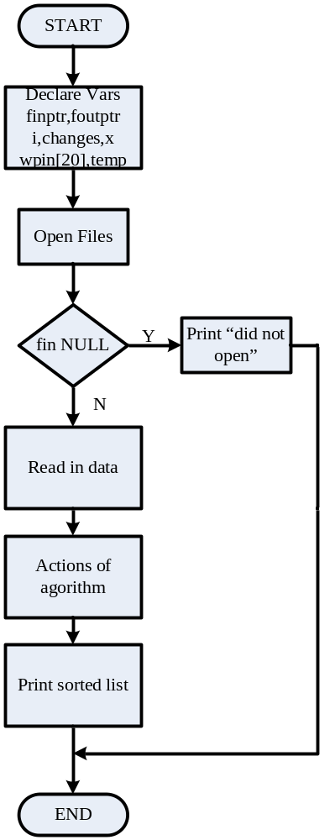
Flow Chart

Slide 21
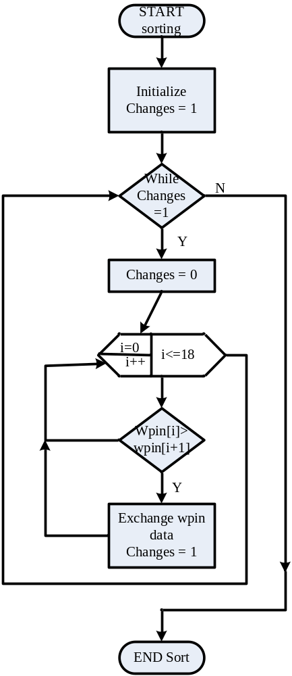
Flow Chart

